Slide 1
2011-2012 Metropolitan School District of Washington Township Teacher of the Year Awards
Presented By:

Slide 2
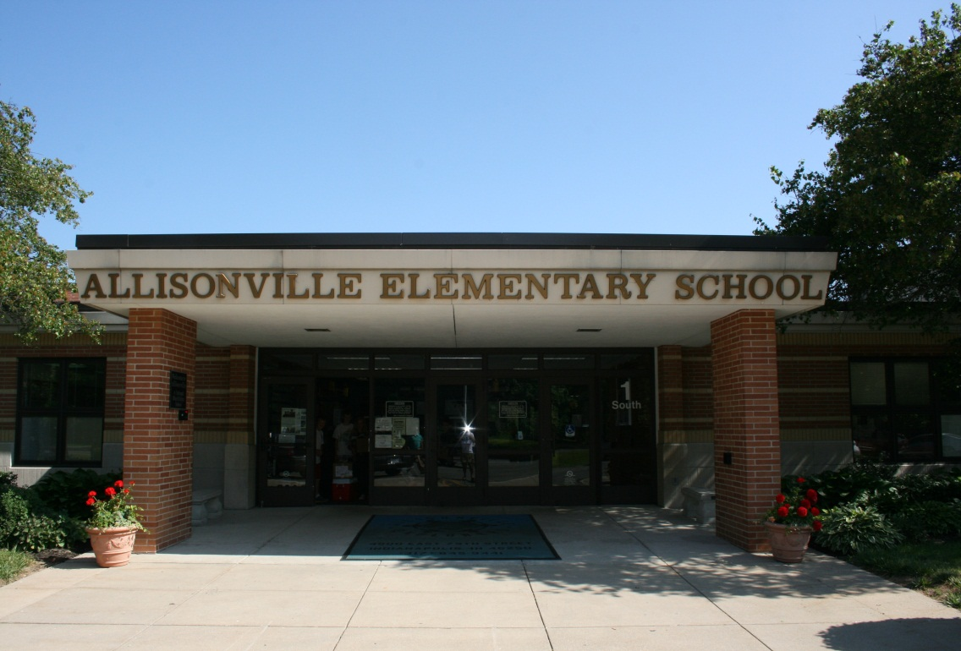
Allisonville Elementary

Slide 3
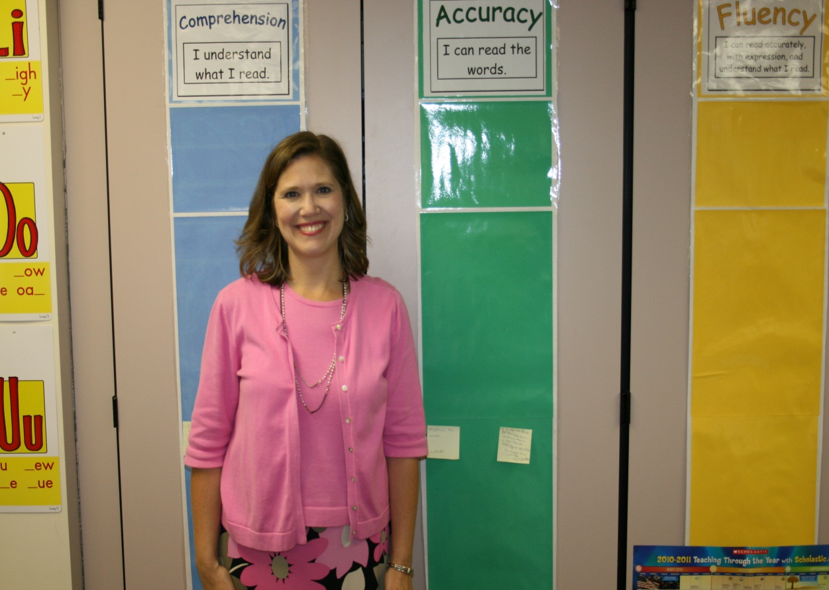
Kathleen Ferguson

Slide 4
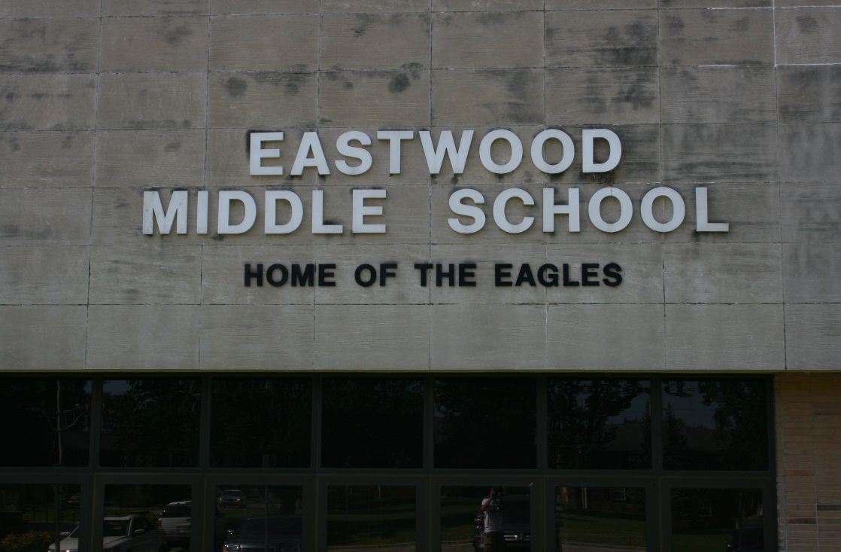
Eastwood

Slide 5
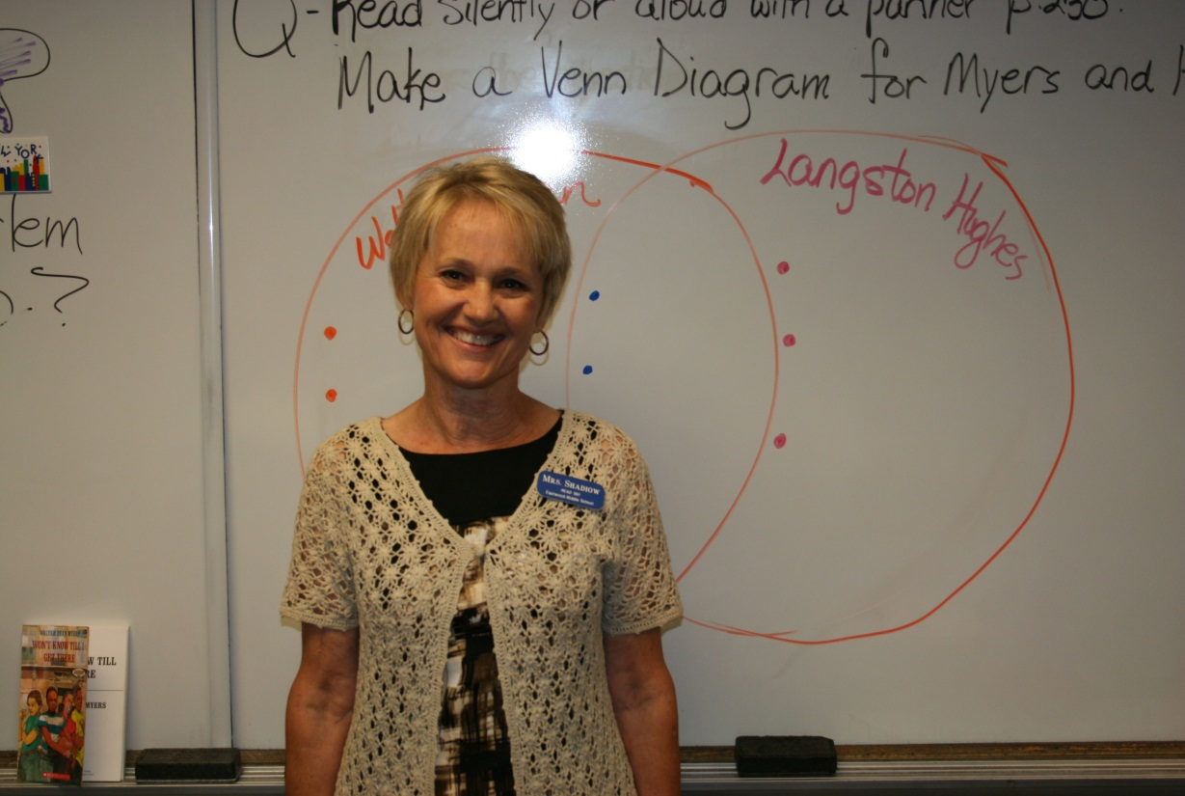
Carla Shadiow

Slide 6
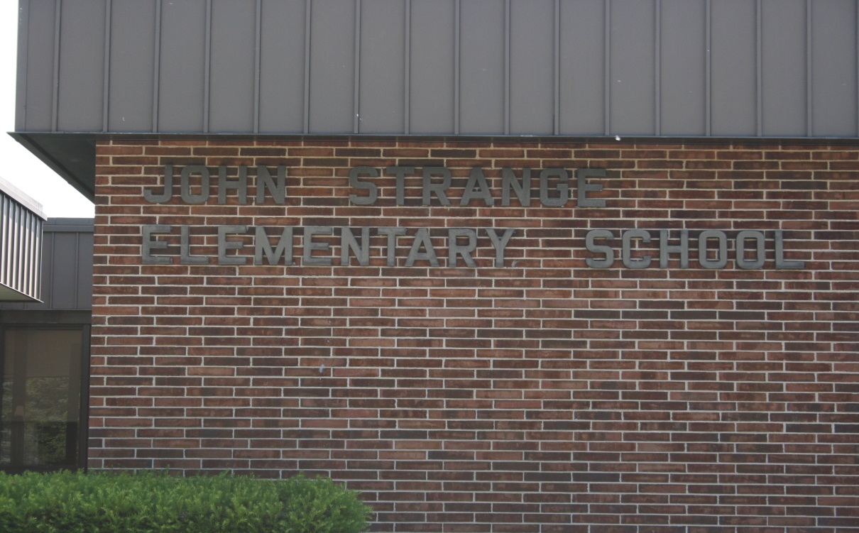
John Strange

Slide 7
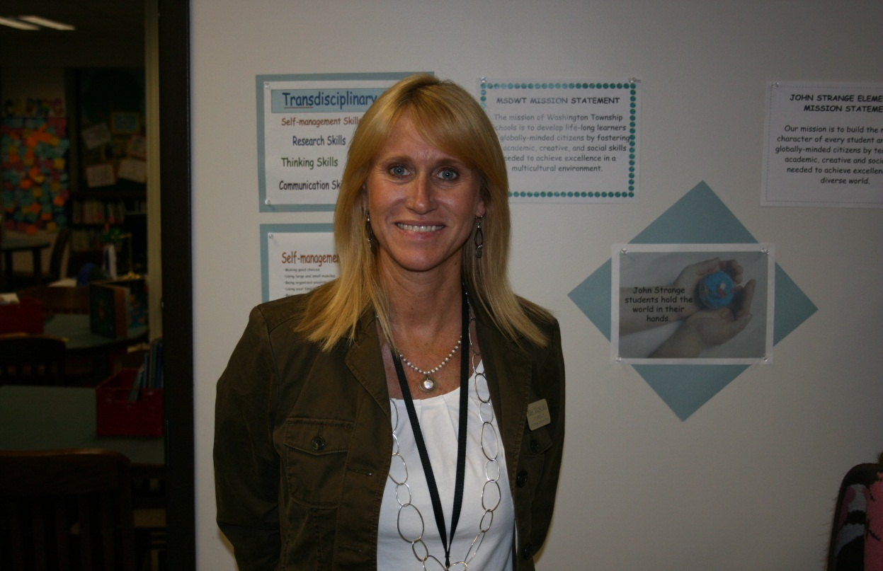
Kim Matsuoka

Slide 8
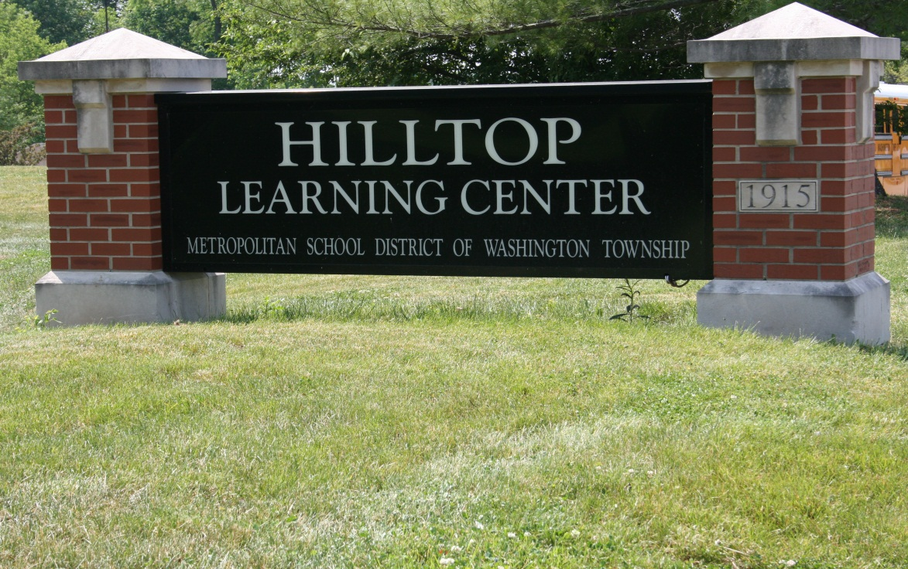
Hilltop

Slide 9
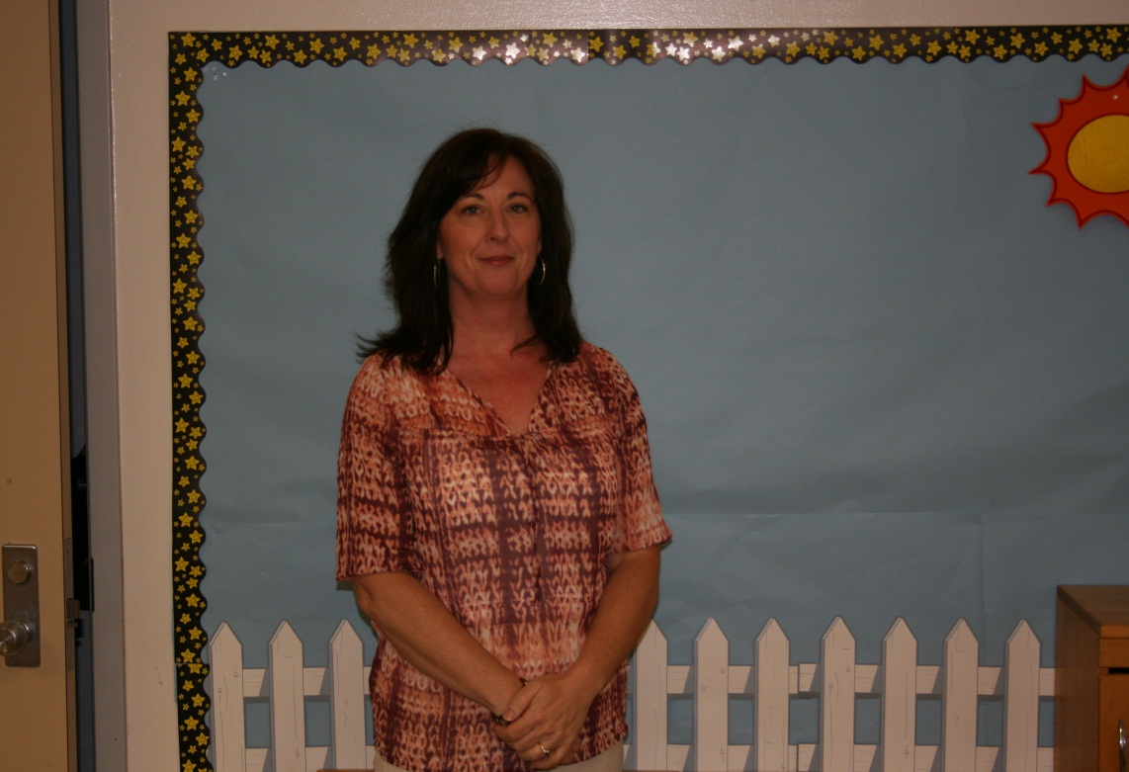
Lori O’Leary

Slide 10
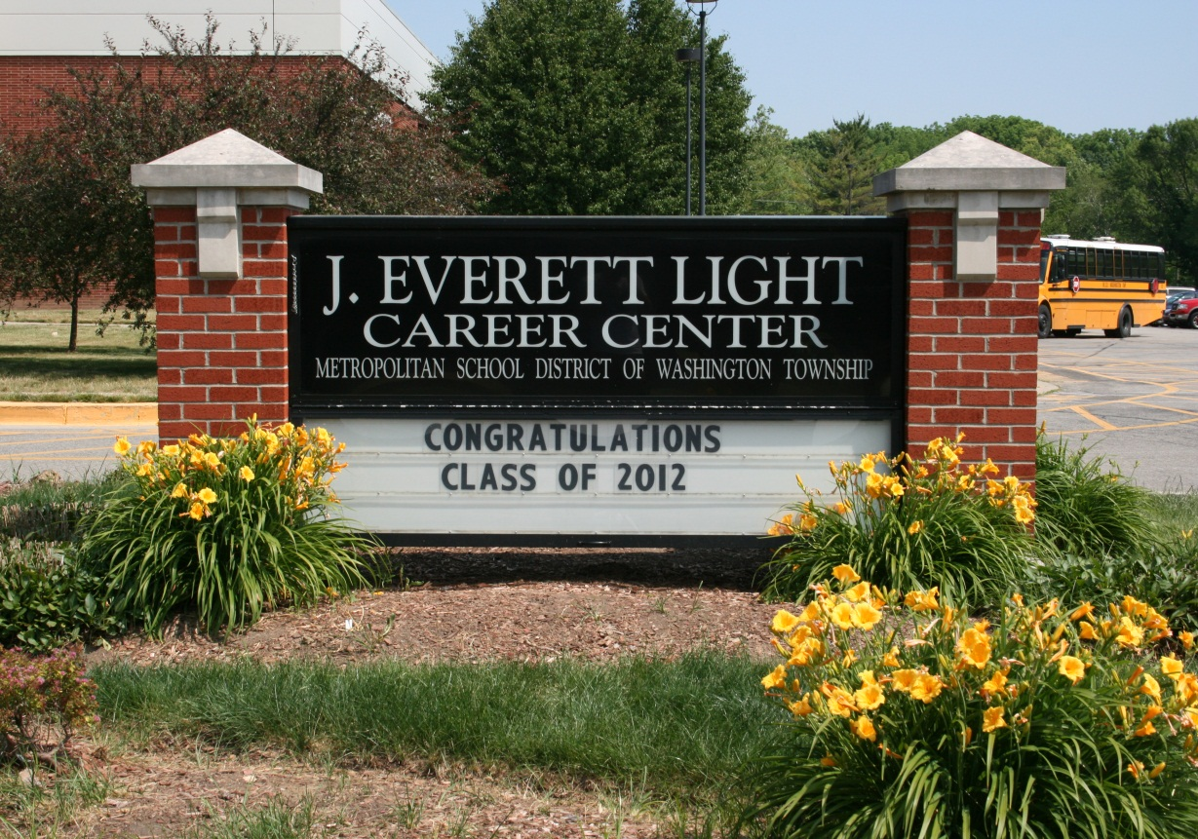
JELCC

Slide 11
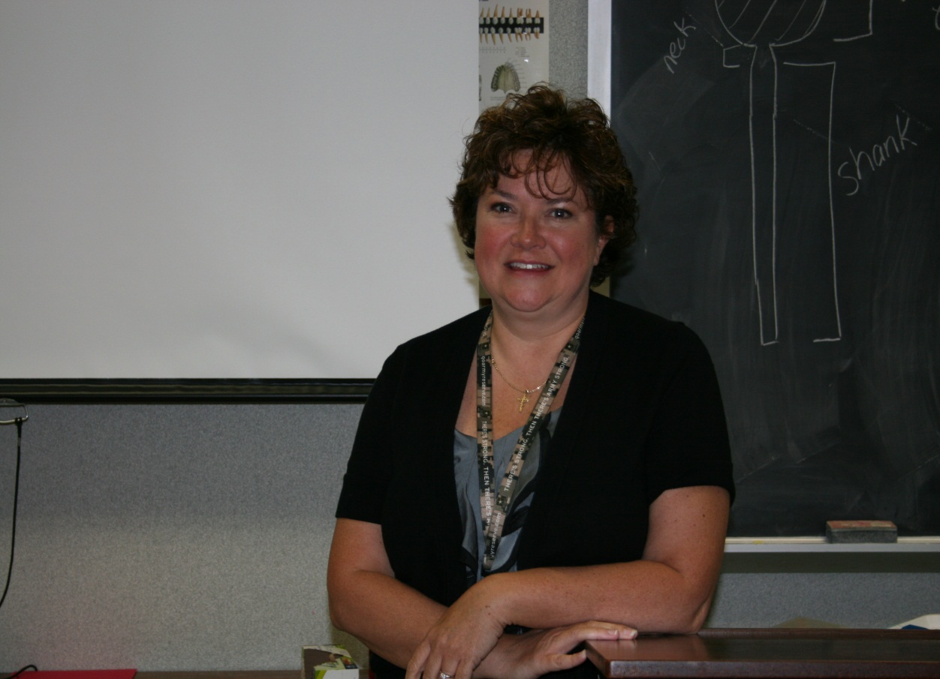
Nicole Albers

Slide 12
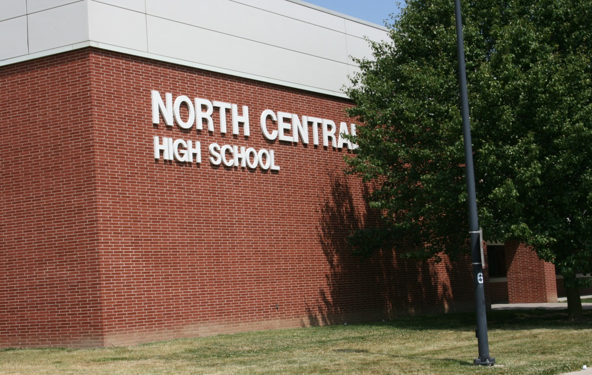
North Central HS

Slide 13
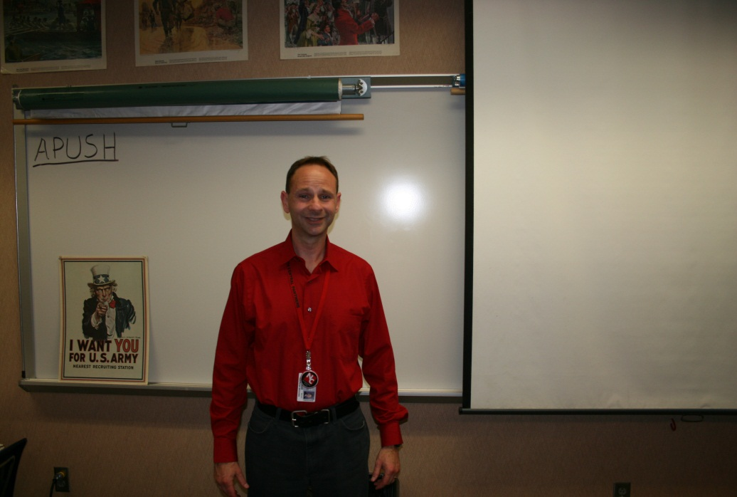
Andy Wiggins

Slide 14
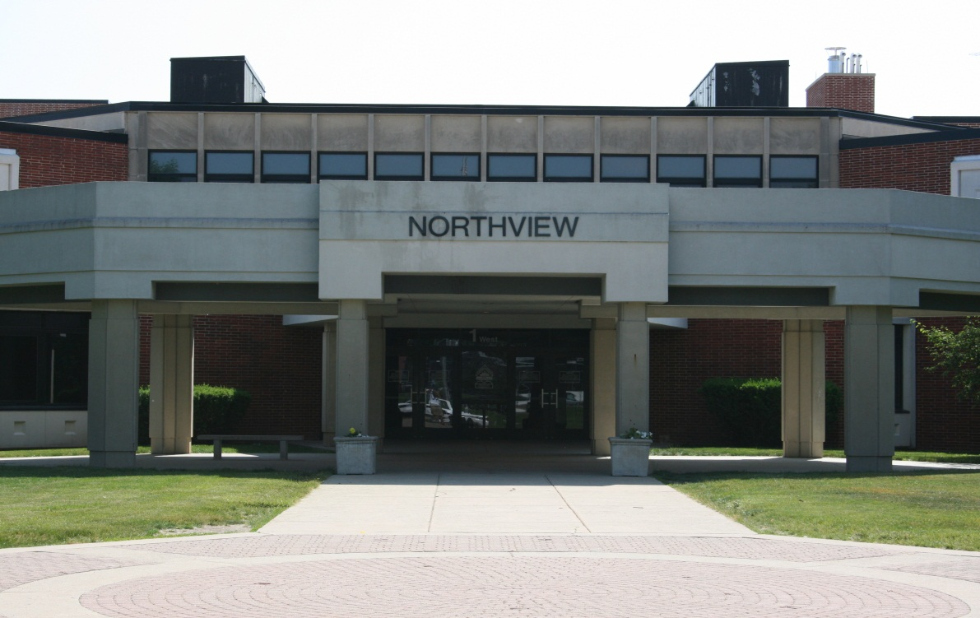
Northview MS

Slide 15
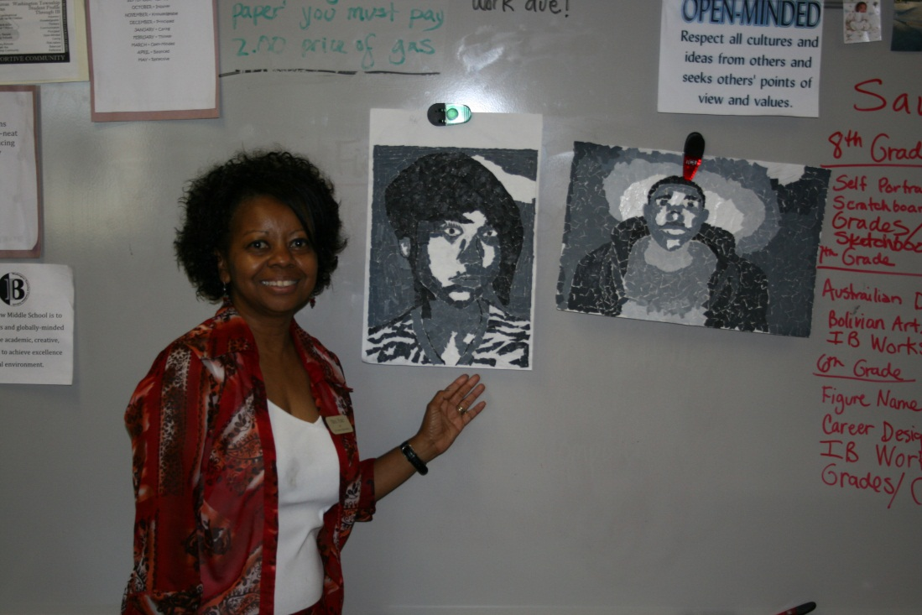
Marionne Fort

Slide 16
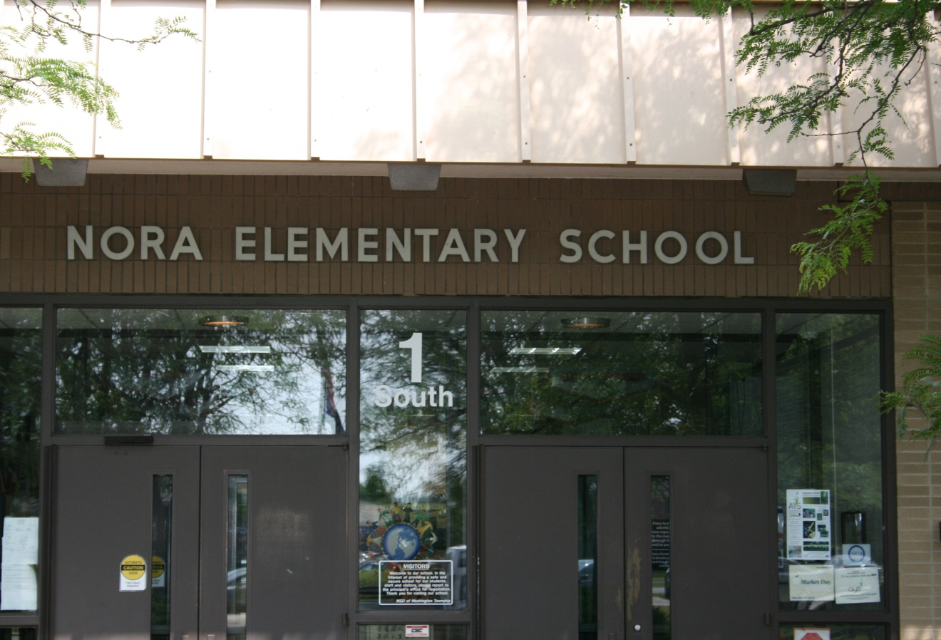
Nora

Slide 17
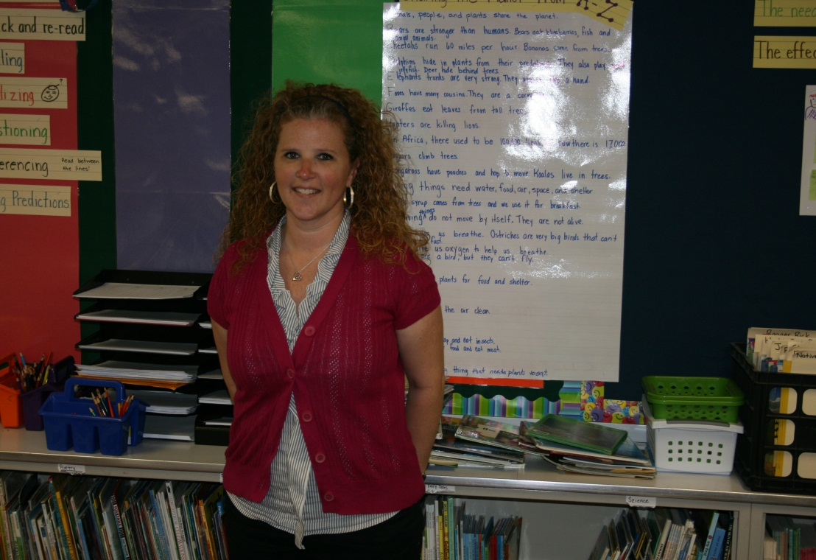
Paige Hackerd

Slide 18
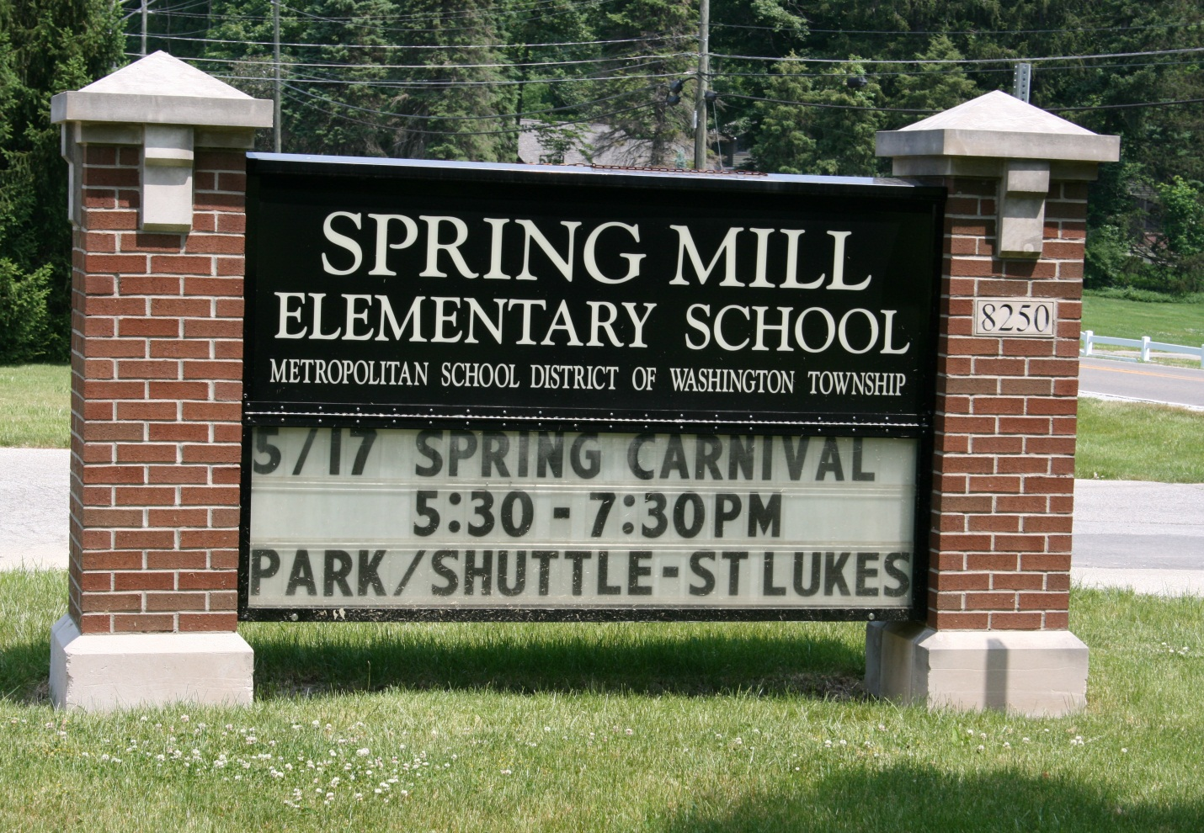
Spring Mill

Slide 19
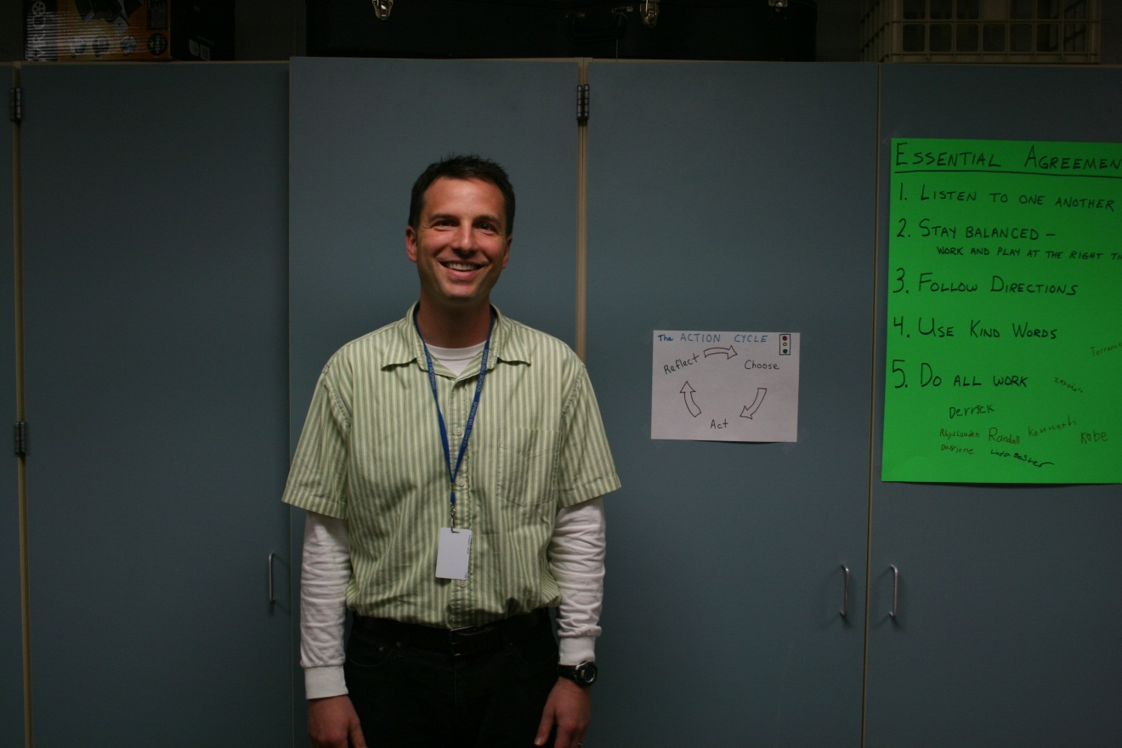
David Raes

Slide 20
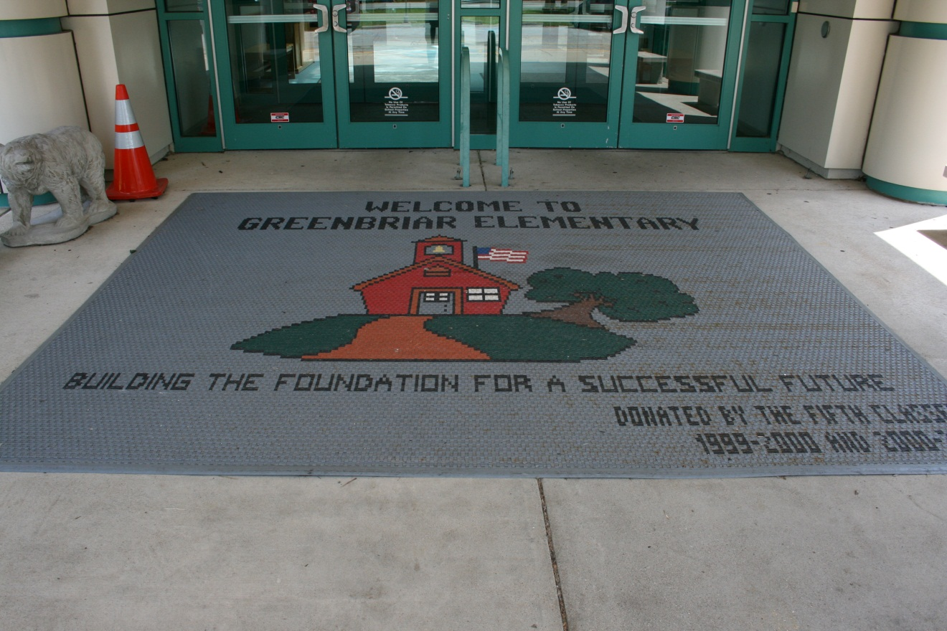
Greenbriar

Slide 21
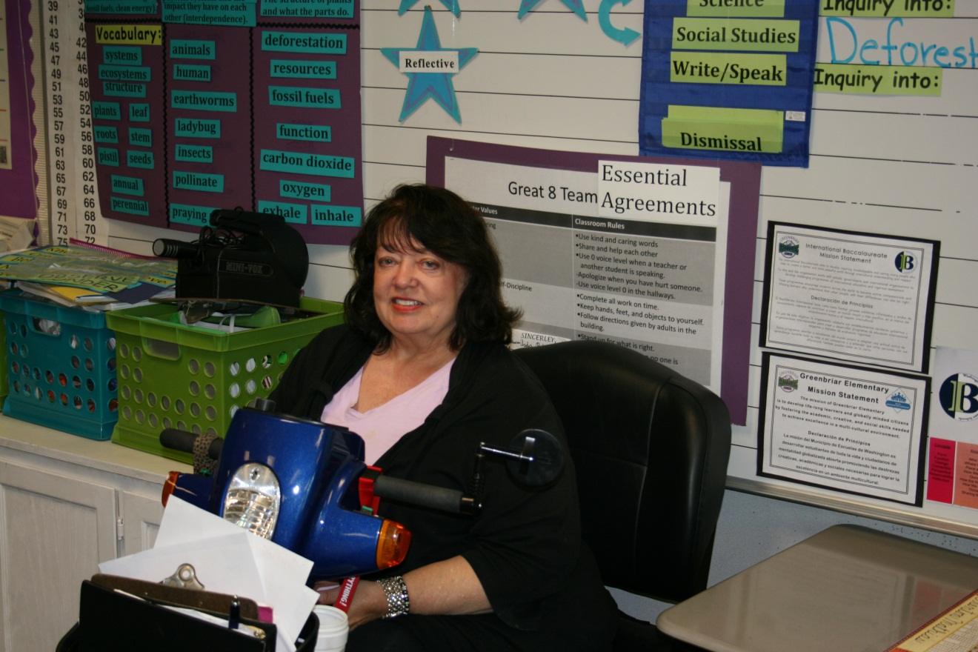
Kathy Robbins

Slide 22
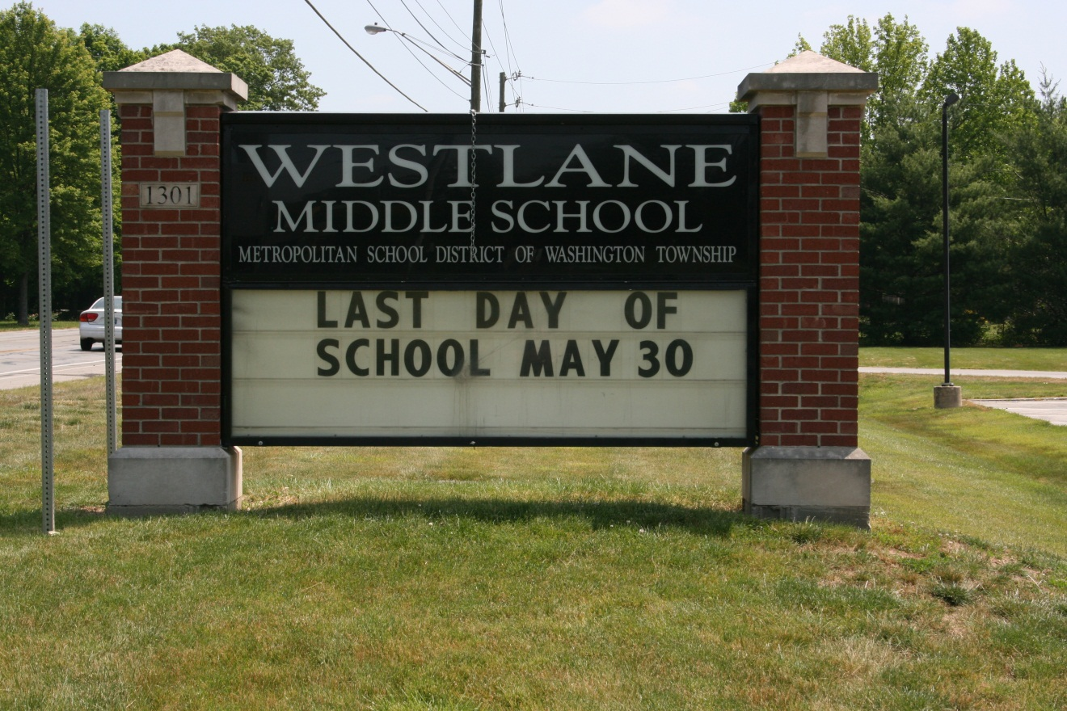
Westlane

Slide 23
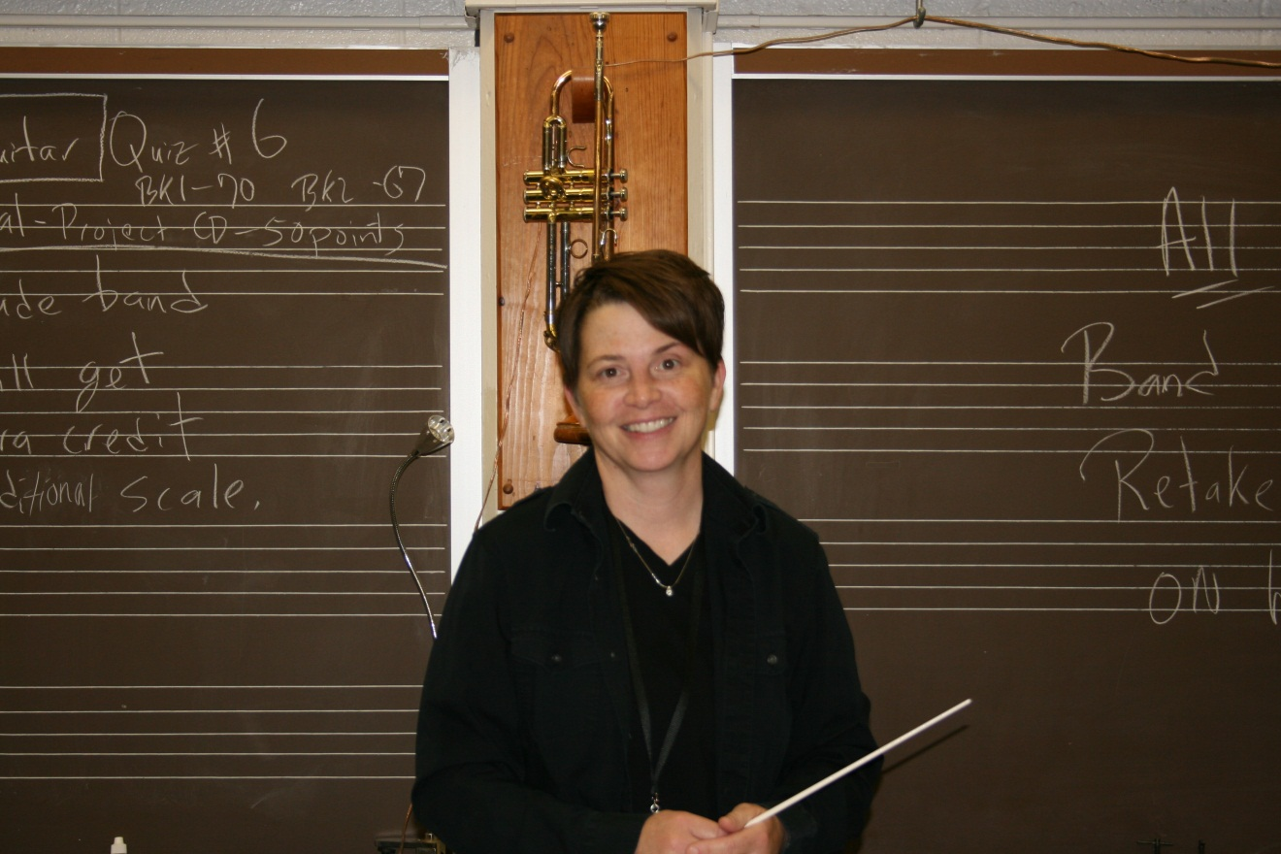
Holly May

Slide 24
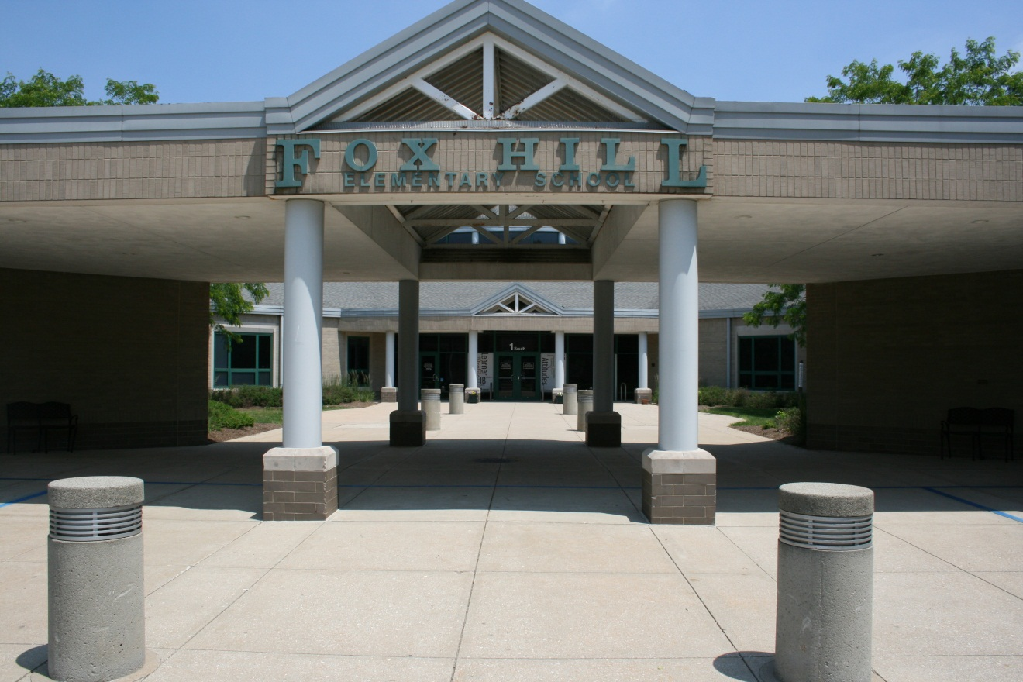
Fox Hill

Slide 25
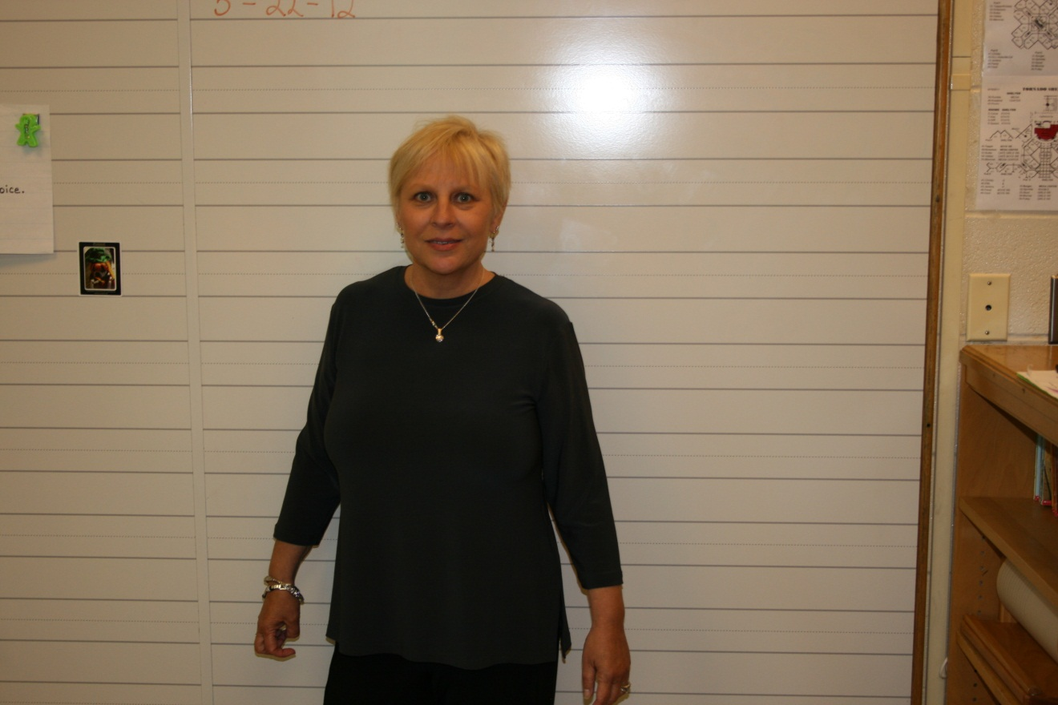
Emily Kniesly

Slide 26
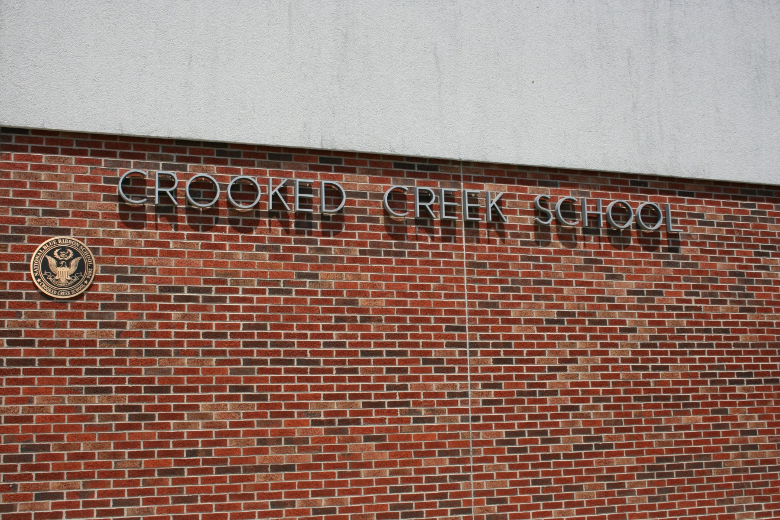
Crooked Creek

Slide 27
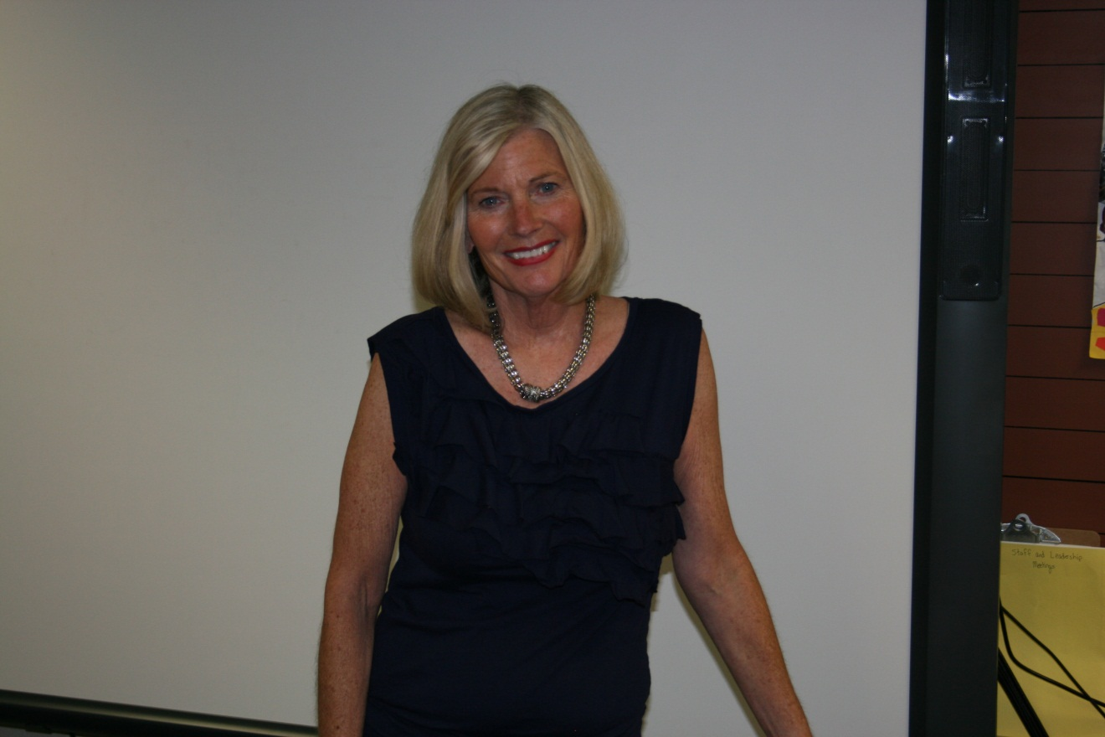
Laura Mathews

Slide 28
Congratulations 2011-2012 TEACHERS OF THE YEAR
Kathleen Ferguson
Carla Shadiow
Kim Matsuoka
Lori O’Leary
Nicole Albers
Andy Wiggins
Marionne Fort
Paige Hackerd
David Raes
Kathy Robbins
Holly May
Emily Kniesly
Laura Mathews

Slide 29
WILL YOU BE NEXT YEAR’S TEACHER OF THE YEAR?
GO FOR IT!!

